Slide 1
Rewritable Random Access DNA Based Storage System
Guided by Prof. Manish Kumar Gupta

Slide 2
—Bill Gates, The Road Ahead
“DNA is like a program but far, far more advanced than any software ever created.”

Slide 3





Our Team
Nisarg Nampurkar
201901188
Jemish Variya
Harikrishna Patel
201901112
201901212
201901457
Ashray Kothari
Raj Patel
201901306

Slide 4
Agenda
1
Introduction
2
Literature Review
3
About Our System
4
References

Slide 5
1
Introduction

Slide 6
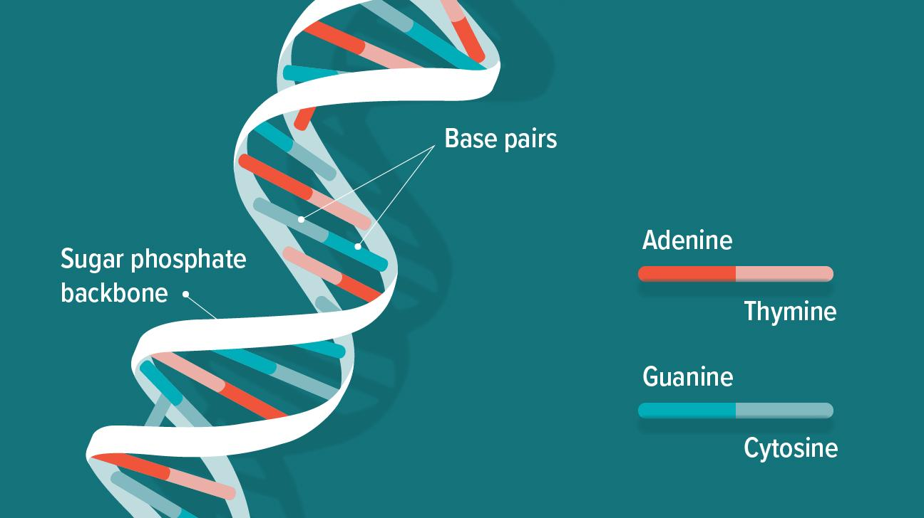
DNA
Deoxyribonucleic acid (DNA) is the molecule that carries the genetic information for the development and functioning of an organism.
The two DNA strands are called polynucleotides since they are composed of simpler monomer units called nucleotides.
Each nucleotide is composed of one of four nitrogen-containing nucleobases - cytosine (C), guanine (G), adenine (A) or thymine (T).
https://www.google.com/url?sa=i&url=https%3A%2F%2Fwww.healthline.com%2Fhealth%2Fwhat-is-dna&psig=AOvVaw0L-FCjgJhNtN_Qc68VlfX6&ust=1668779266725000&source=images&cd=vfe&ved=0CBAQjRxqFwoTCJCyg66ttfsCFQAAAAAdAAAAABAE

Slide 7
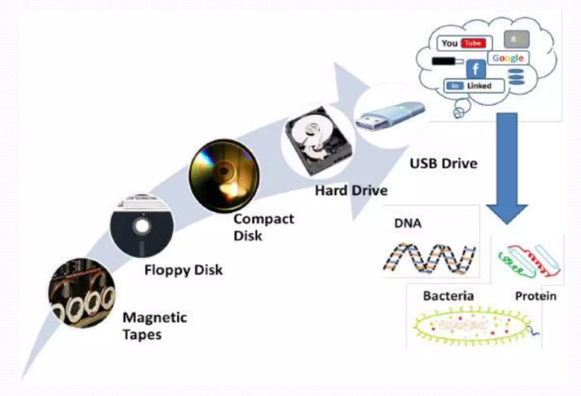
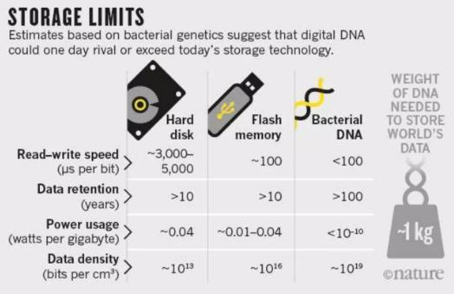
DNA STORAGE SYSTEM
Finding the ways to store data efficiently and economically is getting more and more harder.
The exotic solution can be archiving information in DNA molecules.
https://www.researchgate.net/profile/Manish-Gupta-61/publication/277023595/figure/fig1/AS:294506877472784@1447227319886/Advancement-in-the-field-of-data-storage-devices-is-shown-here-New-paradigm-to-store.png
DNA digital data storage is the process of transcoding of binary data to strands of DNA and vice versa.
It has recently been announced that 1 gramme of DNA can contain 215 petabytes (215 million gigabytes).
https://media.springernature.com/w300/springer-static/image/art%3A10.1038%2F537022a/MediaObjects/41586_2016_Article_BF537022a_Figc_HTML.jpg

Slide 8
2
Literature Review

Slide 9

RELATED WORK
Several studies have described designs for archival DNA-based storage in response to the growing need for enormous data repositories.

Slide 10
Norbert & Mikhail
Genetic Memory
Church & Goldman
Practical Storage
1953
1988
2015
Watson & Crick
DNA structure
1960
Pixel Davis
Storage
2013
Grass
RS code
Rewritable, Random Access DNA Storage System

Slide 11
TRADITIONAL CODING SCHEMES
Single parity-check Coding
Huffman Coding
Differential Coding
Compression of DATA
Removal of repeated consecutive bases in DNA String
Addition of Controlled Redundancy which helps in reducing assembly errors

Slide 12
ISSUES
Single parity repetition encoding and differential encoding, sometimes known as RS codes, are unsuccessful against long substrings with a lot of GC content and other error-prone sequence patterns.
Both differential codes and Huffman codes are fixed-to-variable length compressors which could cause catastrophic error propagation when there is sequencing noise.

Slide 13
The reason to reconstruct the whole text is to read or recover the information encoded even in a few bases is an even more significant issue.
Additionally, all the current designs doesn’t support rewrite operation.
The first restriction is a major drawback because it typically necessitates accommodating access to particular data parts.
The second restriction prevents the use architectures that require remembering the history of edits, storing frequently updated data, and less frequent data editing.

Slide 14

SOLUTION
We develop a re-writable and random-access DNA based storage architecture, with built-in error correction used for selective information access and encoding.
The Addresses contained in the DNA strings are uncorrelated to each other.
Encoding is accomplished by concatenating correctly terminated prefixes (of the addresses). Prefix encoding format allows block to be rewritten later.
Rewriting is done using OE-PCR and gBlock DNA editing procedures.

Slide 15
3
About Our System

Slide 16
System Description
Our system uses severely scoped coding methods of editing DNA structures.
The system provides selective information access and encoding with built-in error-correction capabilities.
The addresses are intended to be mutually uncorrelated to be independent from each other.
This encoding technique represents a unique variation on prefix-synchronized coding.
The system ensures data reliability, sensitivity and precision of retrieval while maintaining a high data storage capacity.

Slide 17
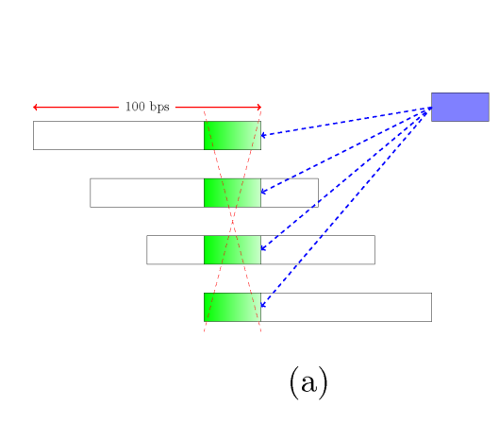
The scheme’s storage format consists DNA strings which covers encoded expressed text which is sampled of the size of 100 bps. Other than both ends, the fragments are overlapping on 75 bps, giving 4-fold coverage.
If we want to rewrite a block, all its four fragments containing are needed to be selected and rewritten to record the new highlighted segment.
https://arxiv.org/pdf/1505.02199.pdf

Slide 18
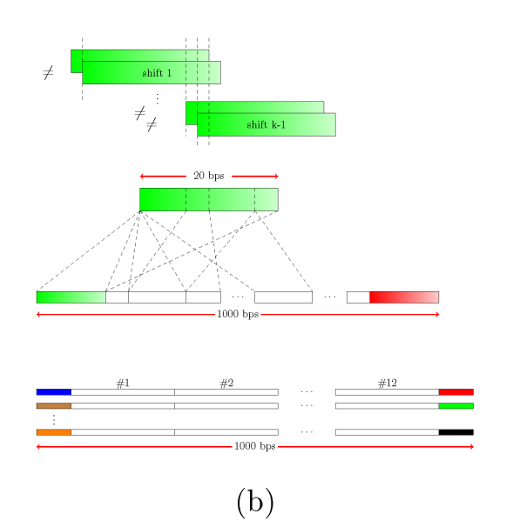
The construction process of address sequence uses the idea of auto-correlation and cross - correlation.
Mutually uncorrelated addresses are chosen and address of size 20 bps are appended on left and right side.
https://arxiv.org/pdf/1505.02199.pdf

Slide 19
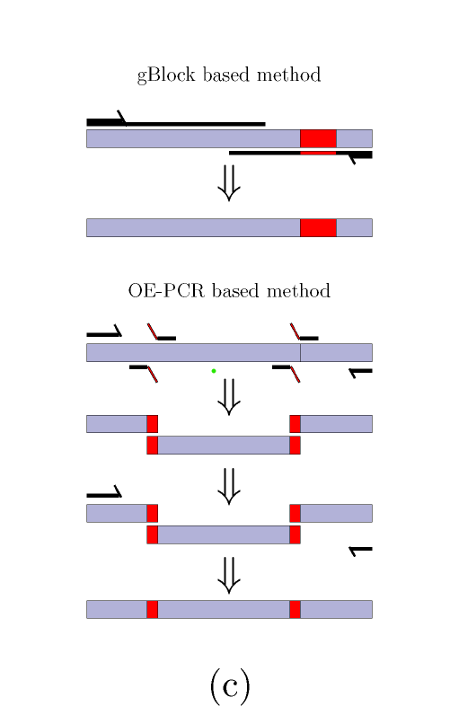
For content rewriting gBlock Method is used for short rewrites and OE-PCR method is used for sequential rewriting of longer blocks. OE-PCR is also cost-efficient.
https://arxiv.org/pdf/1505.02199.pdf

Slide 20
COMMA FREE CODES
It is a block code where no concatenation of codewords that contains a valid codeword as substring.
It allows simple, yet efficient, synchronisation protocols.
A ‘drawback’ that in order to verify a string whether is a codeword or not we have to perform exhaustive search over set of sequences.

Slide 21
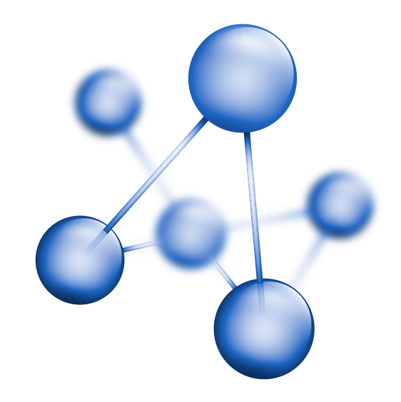

Overcoming that drawback by prefix synchronised codes
⇒A special family of comma free codes.
⇒ It has the form,

Slide 22
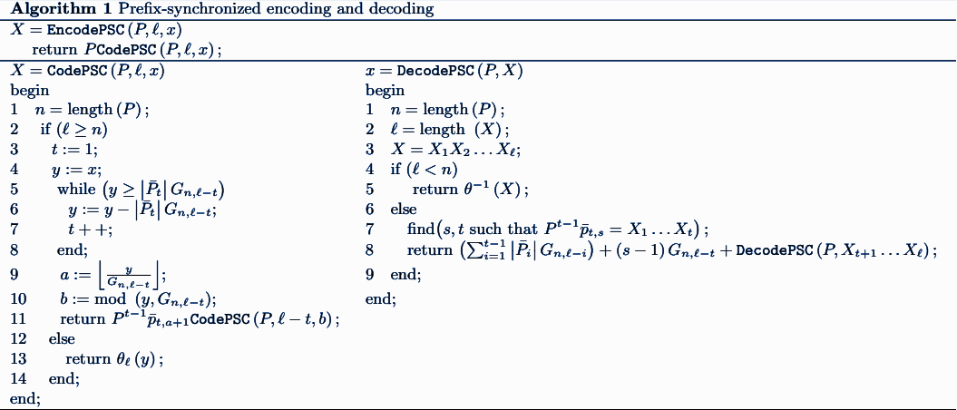
PREFIX SYNCHRONIZED
ENCODING - DECODING

Slide 23
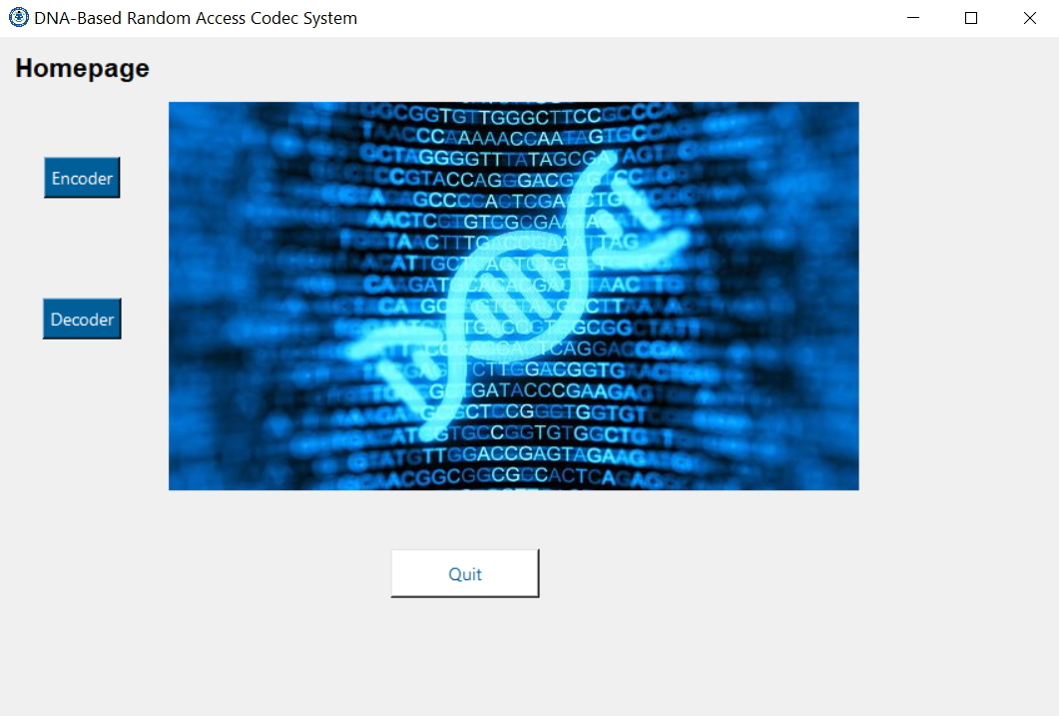
Software Homepage

Slide 24
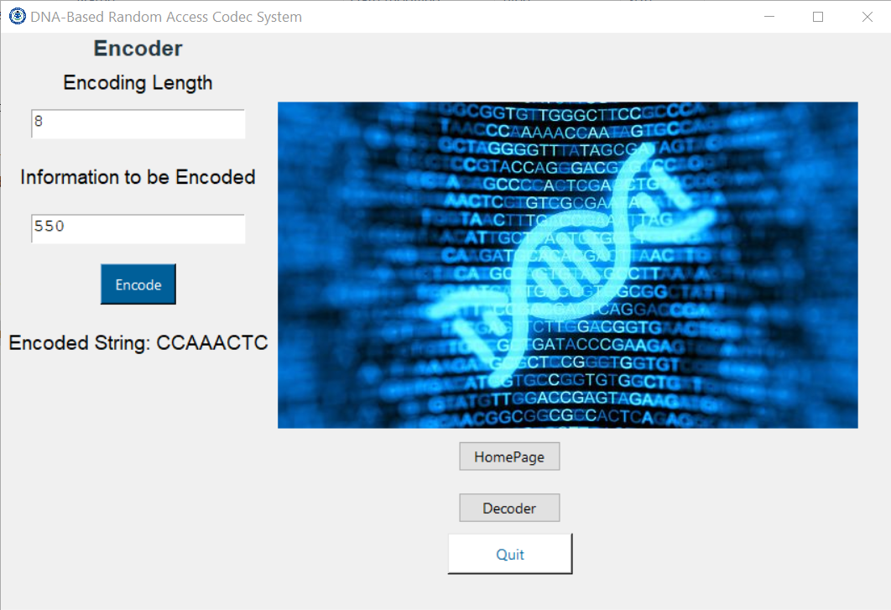
Encoder

Slide 25
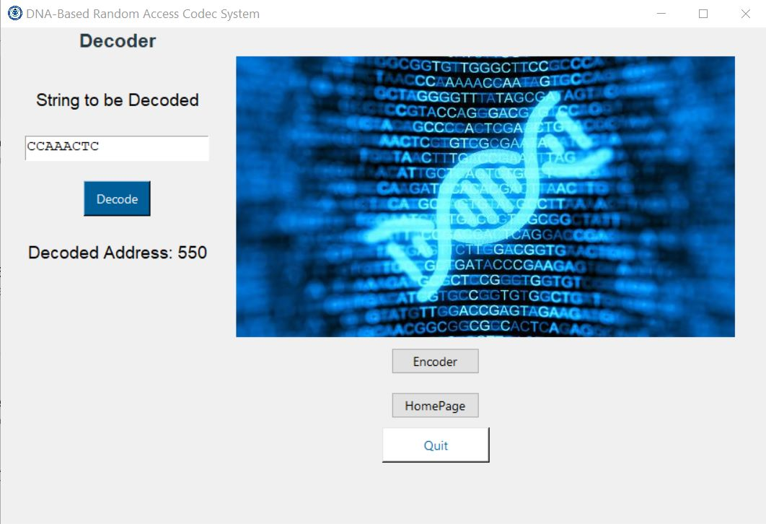
Decoder

Slide 26
Contribution
Jemish Variya - 20%
Nisarg Nampurkar - 20%
Harikrishna Patel - 20%
Raj Patel - 20%
Ashray Kothari - 20%

Slide 27
REFERENCES
[1] E. Gilbert. Synchronization of binary messages.
IRE Transactions on Information Theory, 6(4):470–477, 1960.
[2] Maya Levy and Eitan Yaakobi. Mutually uncorrelated codes for dna storage.
In 2017 IEEE International Symposium on Information Theory (ISIT), pages 3115–3119, 2017.
[3] S. M. Hossein Tabatabaei Yazdi, Yongbo Yuan, Jian Ma, Huimin Zhao, and Olgica Milenkovic. A rewritable, random-access dna-based storage system.
Scientific Reports, 5, 2015.

Slide 28
THANK
YOU !

